Slide 1
Regression

Slide 2
Regression:
Regressiya
Bir yoki bir nechta qiymatga bog’liq holda biror qiymatning qanday o’zgarishini tahlil qilish usuli

Slide 3
Regressiya turlari:
Linear Regression – chiziqli regressiya:
Simple Linear Regression – Oddiy chiziqli regressiya
2. Multiple Linear Regression – Ko’p qiymatga bog’liq regressiya
Non-Linear Regression – chiziqli bo’lmagan regressiya
Polynomial regression
Exponential Regression
Logarithmic Regression
Power Regression
Sigmoid (Logistic) Regression

Slide 4
Linear
Regression

Slide 5
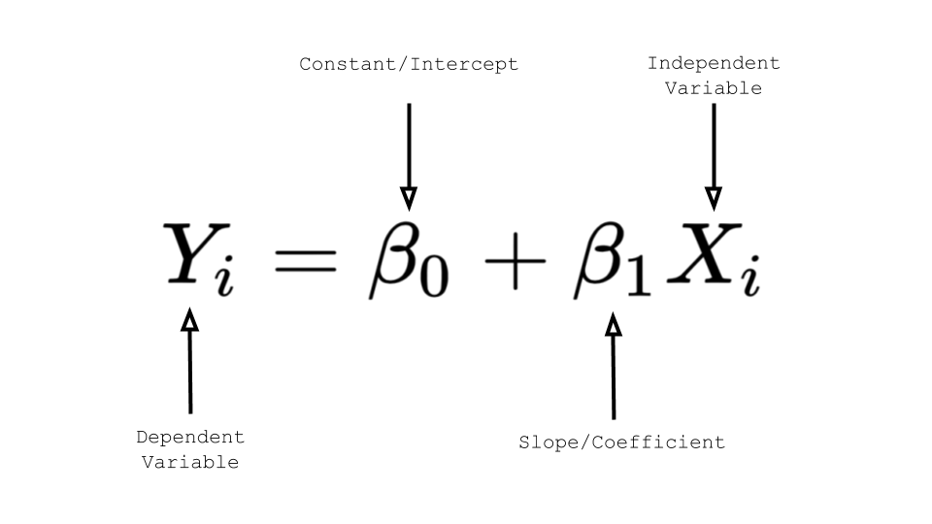
Simple Linear Regression – Oddiy chiziqli regressiya
Biror qiymatning o’zgarishi faqatgina bitta qiymatga bog’liq bo’lishi.
Ish tajribasi (yil) | Oylik maosh (so’m)
20 | 32.500.000
5 | 8.200.000
10 | 16.250.000
7 | 12.670.000

Slide 6
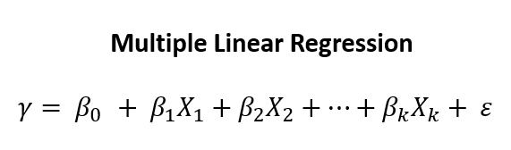
Multiple Regression:
Biror qiymatning o’zgarishi bir nechta qiymatga bog’liq bo’lishi.
Ish tajribasi (yil) | Yosh | Ingliz tilini bilishi | Oylik maosh (so’m)
20 | 40 | Ha | 28.500.000
5 | 27 | Yo’q | 8.200.000
10 | 30 | Ha | 16.250.000
7 | 34 | Ha | 12.670.000

Slide 7
Non-Linear
Regression

